Slide 1
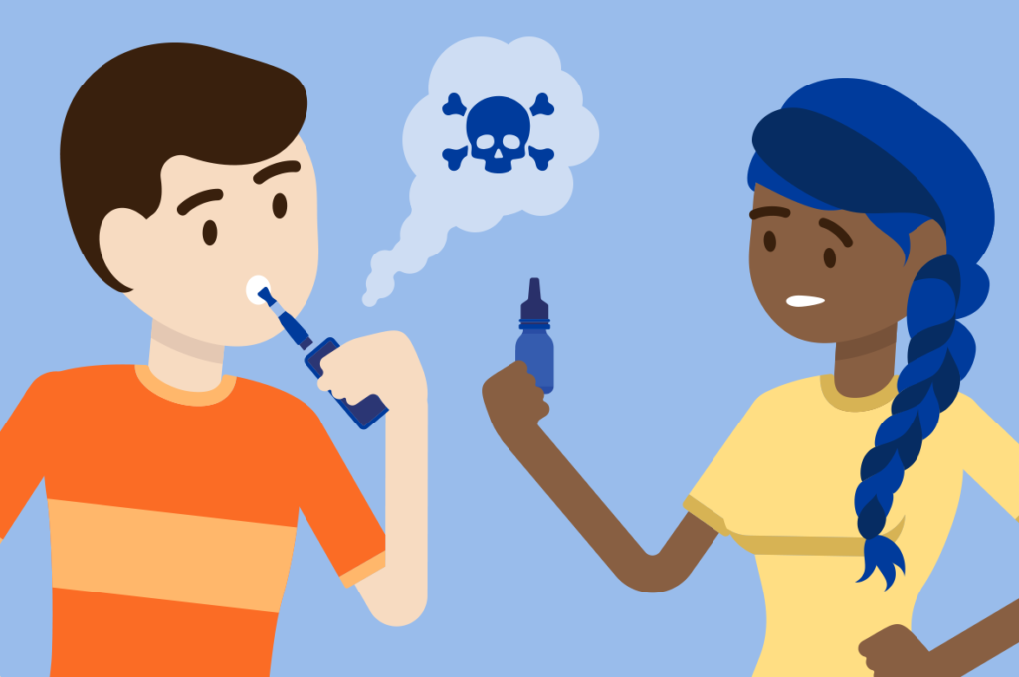
Vaping
www.healthyhounslow.co.uk

Slide 2
Does anyone know what a vape is?
They contain harmful chemicals such as:
Propylene glycol – used to make antifreeze and paint solvent
Vegetable glycerin – found in soaps and deodorants
E-cigarettes, or vaping products, can be used to deliver nicotine, flavourings, chemicals, and other substances. They are known by many different names and come in many shapes, sizes, and device types.
Vapes were first made to help people give up smoking cigarettes.
Vapes don’t contain some of the very harmful chemicals that cigarettes do BUT they still contain many chemicals, and nicotine – this is a chemical which you can get addicted to and want more of. Cigarettes also contain nicotine.
So, they are good to help people give up smoking but are not good for anyone who never smoked.
If you don’t smoke, don’t vape.
Notes:
Ask the class what they think vapes are first. What do they look like? Have they seen people vaping? Have they noticed the steam? do they know what they contain?
Cigarette are very unhealthy, they contain chemicals linked to many types of cancer, these chemicals thicken your blood and can stop your heart working as well as it should and they cause lung damage which cause breathing problems.
It feels like smoking because when someone vapes they breath in steam from the vape and breath it out - what looks like smoke is actually steam.
Do they think they are safe?(answer – if you are a cigarette smoker they are safer than cigarettes, but they aren’t completely safe so if people who aren’t cigarette smokers start to vape they may be harming their health).

Slide 3
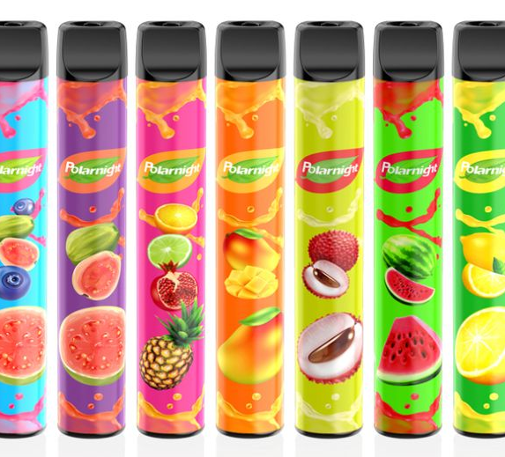
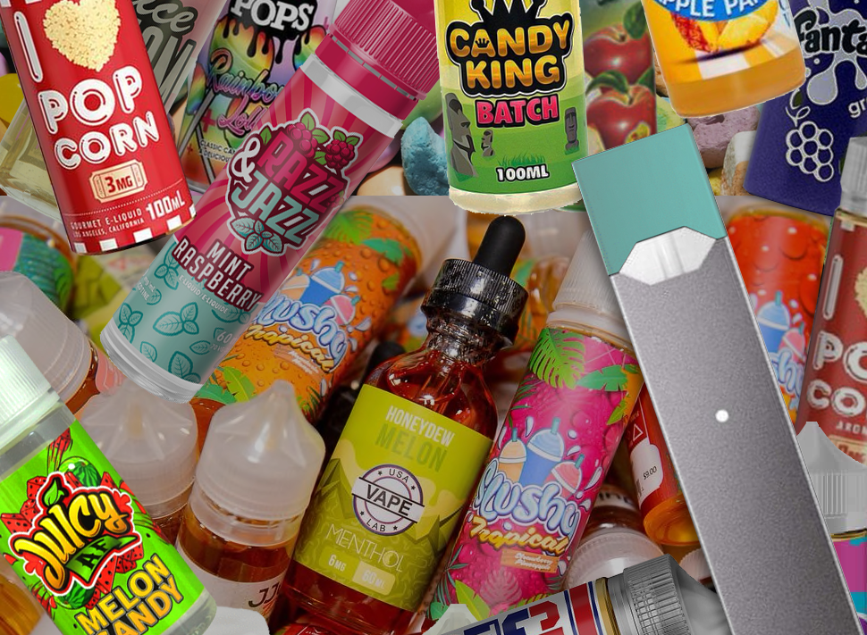
Vapes are often aimed at children – what flavours have you seen?
Social media makes vaping look fun and attractive.
Flavours like fruit, chocolate, and candy in colourful packaging are aimed at children and young people.
The companies who do this are not interested in your health, they just want to make money.

Slide 4
“It’s cool”
Why do you think some young people want to start vaping?
“I’m bored, I need something to do”
“I’m stressed & anxious – it might make me feel better”
“I’m curious, I’ll give it a try”
“My friends are all doing it”
Notes:
Ask them this first and go through one by one – there may be other suggestions from them.

Slide 5
Vaping is not safe for children or young people
Nearly all vapes contain nicotine, the addictive chemical found in cigarettes. If you use vapes often, you may get addicted to them and feel bad when you haven’t vaped for a while. This will make you bad-tempered and anxious and you won’t be able to concentrate well.
Vapes are still quite new, and little is known on the health effects on young vapers over time. Children and young people vaping today are our “guinea pigs”.
A young person’s brain is still developing, and scientists believe that nicotine could interfere with brain development. But more research is needed on this before they can be sure.
The chemicals in them cause coughing, headaches, dizziness, and sore throats, and can also have more serious effects on the heart and lungs.
Notes:
These are key facts that they need to know to help understand the health effects.

Slide 6
Why you should not try vaping
As well as the health risks, there are other factors…
Disposable vapes cost around £5. So, if you normally use 3 vapes per week, that would cost you £15 every week.
Instead, you could spend your money on…
They are expensive. What could you spend your money on instead of vapes?
There are many dangerous, illegal vapes on the market. These contain unknown chemicals and higher amounts of nicotine, with many more “puffs” than is safe. But they look the same as the legal ones
An Odeon cinema ticket. At £6-8, you and a friend could go to see a movie and buy popcorn for the same price as 1 week with no vapes.
A new Apple Airpods 2nd generation costs £129 = 8 ½ weeks without vapes.
Notes:
Ask what else could they spend the money on?

Slide 7
“Don’t start, it’s bad for you”
We asked older children who vape what advice they would give to younger children. This is what they said…
“Don’t get caught in this trap”
“I would try to stop them and throw it out”
“Vaping will cause you long term problems”
“Think carefully before you start”
Notes:
They may have older siblings or relatives who vape who they admire so this message is important.

Slide 8
Vaping: The Facts!

Slide 9
“It’s cool”
It’s not healthy, it’s expensive and the vape companies are just after your money
“I’m bored, I need something to do”
So, remember the reasons why young people might want to try vaping? What do you think now?
There are much healthier ways to fill your time and some of them are free!
“I’m curious, I’ll give it a try”
Most vapes contain nicotine which is addictive, this can make you bad tempered and lose concentration, making anxiety even worse
“I’m stressed & anxious – it might make me feel better”
There are lots of illegal ones that may be dangerous
Notes:
Recap on the discussion earlier with the new information in context to help put them off starting to vape.

Slide 10
“No, I'm okay thanks – it messes with my asthma”
How would you manage the situation if someone offered you a vape to try? Let's plan for it!
“No, thank you. Vaping is not for me”
“I'm good, I don't want to try it”
IF Callum offers me a vape on the way home, THEN I'll say...
“Nah, not my thing”
...any other ideas?
Notes:
They may have older siblings or relatives who vape who they admire so this message is important.

Slide 11
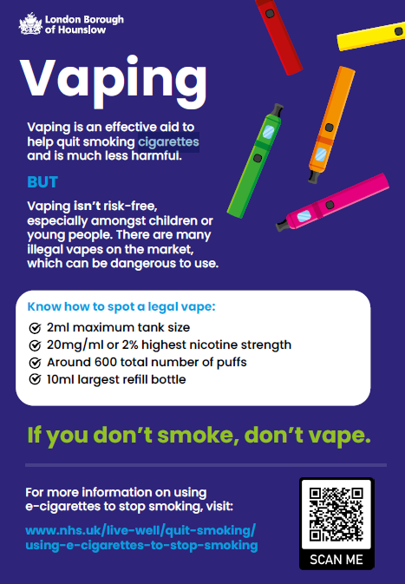
Healthy Hounslow
Healthy Hounslow is a free service to help anyone stop vaping or smoking.
If you need help, speak to your teacher or parent.
Find out more at https://healthyhounslow.co.uk
Or call 0204 559 8200

Slide 12
Activity
Design a poster aimed at children your age to give them information about vaping.
What messages should the poster contain?
How children and young people can get help if they want to stop vaping.
www.healthyhounslow.co.uk
Notes:
Suggestions:
It’s not safe
It affects a child’s brain
It’s addictive
It can make you bad tempered or anxious
The companies don’t care about our health they just want our money
Think of the money you can spend on other things
Dangerous vapes on the market which look just like proper ones
Give Healthy Hounslow details on support to quit.

