Slide 1




Vaping/e-cigarettes in children and young people
Information for parents
www.healthyhounslow.co.uk

Slide 2


We know smoking is bad for our health
A regular smoker’s life expectancy is 10 years shorter than a non-smoker’s.
Cigarettes contain nicotine, tar, and chemicals such as Carbon Monoxide (CO).
Smoking-related deaths are mainly due to cancers (lung, plus 11 other types of cancer), chronic obstructive pulmonary disease (COPD), heart disease and stroke.
15% of Hounslow adults smoke. There is free support to help quit smoking from Healthy Hounslow.
Approx 50% of all smokers die from smoking-related diseases – about 100,000 per year in the UK.

Slide 3
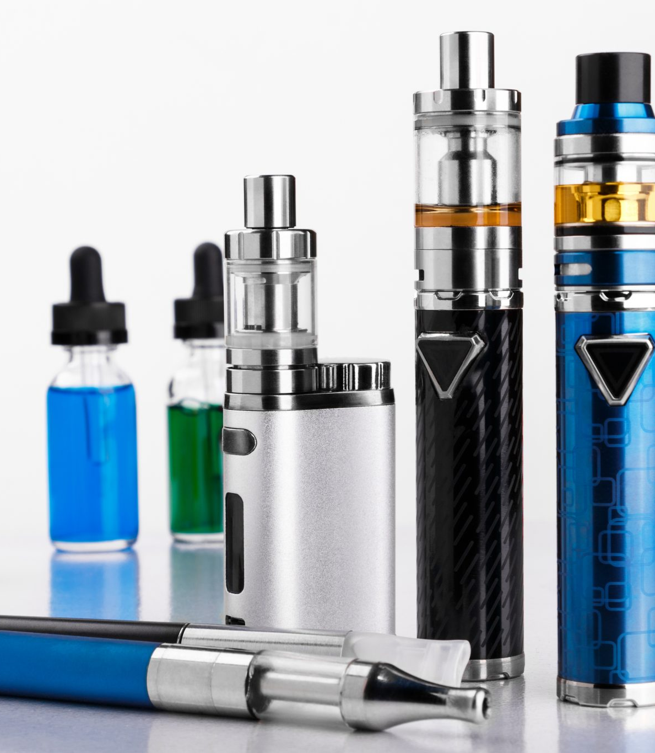

  But what about vaping?

Slide 4
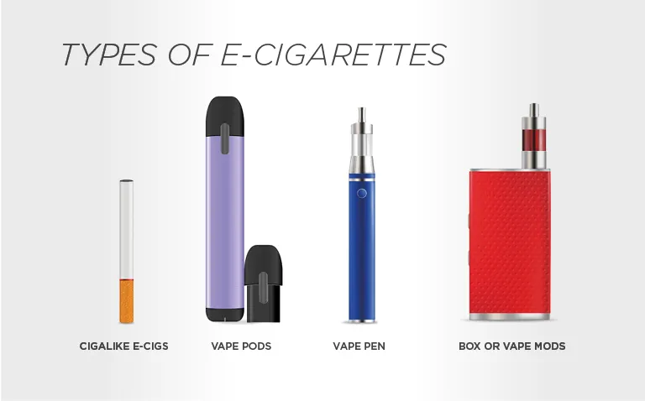
What are vapes/e-cigarettes?
Lots of styles – the most common amongst young people are the disposable ones
Vapes/e-cigarettes work by heating and vaporising a liquid which is then inhaled by the user, simulating the act of smoking.
They contain harmful chemicals such as:
Propylene glycol – used to make antifreeze and paint solvent
Vegetable glycerin – found in soaps and deodorants
This liquid typically contains nicotine, carrier liquids and flavourings

Slide 5

What do they contain?
Unlike cigarettes, they don’t contain tobacco, tar and carbon monoxide which are linked to cancer and cardiovascular/respiratory diseases. It is estimated that they are 95% safer than cigarettes.
So that’s good news, isn’t it??
Most vapes/e-cigarettes contain:
Nicotine, the chemical which makes cigarettes addictive
Chemical carrier liquids
Artificial flavours and colourings
If you don’t smoke, don’t vape.

Slide 6

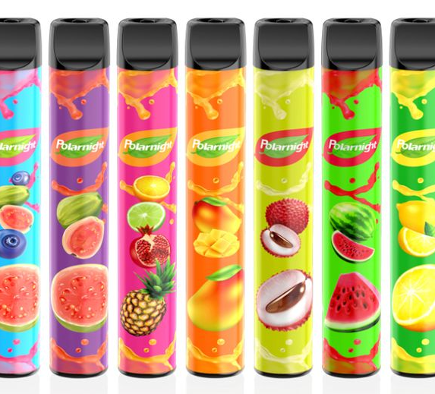


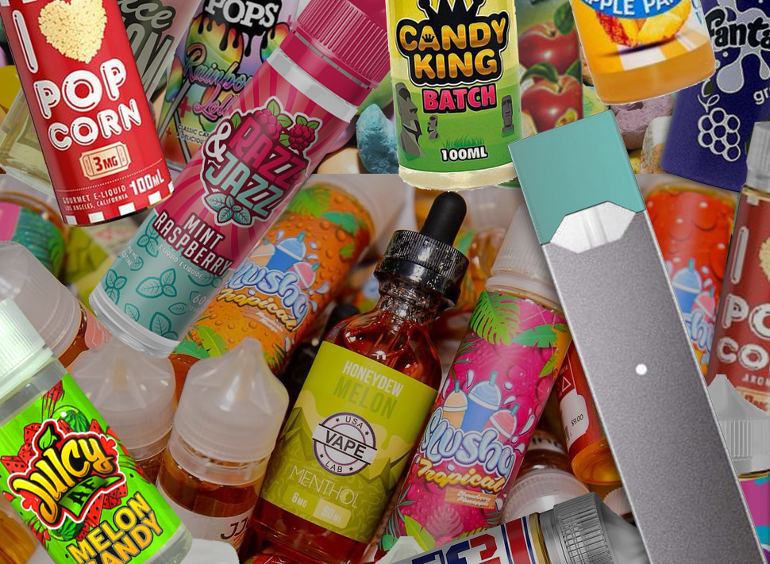


Vapes are often aimed at young people
Social media makes vaping look fun and attractive.
Flavours like fruit, chocolate, and candy in colourful packaging are aimed at children and young people.
The proposed change in legislation will restrict the design and flavours to make them less attractive to children.

Slide 7
They are a relatively new product, and little is known about the health effects on younger users – the children and young people vaping today are our guinea pigs.
Some evidence they may have an adverse effect on physical health – from mild e.g. coughing, headaches, dizziness, and sore throats, to more serious effects on the heart and lungs.
Concerns about young vapers
Irritability and loss of focus due to nicotine withdrawal when not vaping.
Their age is at a time when important changes happen in the brain - concerns about how nicotine from e-cigarettes could interfere with brain development. However, more research is needed before we can draw definite conclusions.
Anyone who hasn’t smoked before who was to start vaping may develop a nicotine addiction. 2024 data suggests young vapers may be more dependent than they were in previous years, with more current vapers reporting strong urges to vape compared to 2020. This suggests that newer products may be increasing nicotine dependency. This may act as a gateway to smoking cigarettes.

Slide 8

Why are we worried?
Who can buy them? It is an offence to sell a nicotine inhaling product to a person under the age of 18, but a recent survey showed that 75% of under 18yr old vapers had bought the vapes themselves.
Schools have reported pupils in years 7, 8, 9, 10 and 11 vaping.
The main reasons for vaping were to “give it a try”, “for fun/I like it”, “liking the flavours”, or “other people do it, so I join in”.
In a 2024 study, around 18% of 11–17-year-olds have tried vaping.
Most children aged 11-17 (58%) wrongly believe that vaping is about the same or more harmful than smoking, but this doesn’t appear to be putting children off trying vaping.
Illegal vapes are easy to get hold of and contain far more nicotine in them, a much higher volume (more puffs) and dangerous levels of lead, nickel and chromium.
Vapes can be adapted to smoke marijuana and other drugs such as spice (synthetic marijuana).
Notes:
Ask what else could they spend the money on?

Slide 9


Illegal vapes
There are many dangerous, illegal vapes on the market…
The Council’s Trading Standards team are responsible for enforcing the relevant laws relating to the safety and sale of e-cigarettes/vapes.
Know how to spot a legal vape:
  2ml maximum tank size
  20 mg/ml or 2% highest nicotine strength
  Around 600 total number of puffs
  10ml largest refill bottle
There must be a clear label and a health warning: “This product contains nicotine which is a highly addictive substance” which covers 30% of the packaging.
The label must include a list of contents and have the appropriate hazard or danger warning signs.
Contact Hounslow Council’s Trading Standards for any concerns about illegal vapes sales and/or under-age sales of vapes (under 18 yrs) tradingstandards@hounslow.gov.uk
Notes:
Ask what else could they spend the money on?

Slide 10
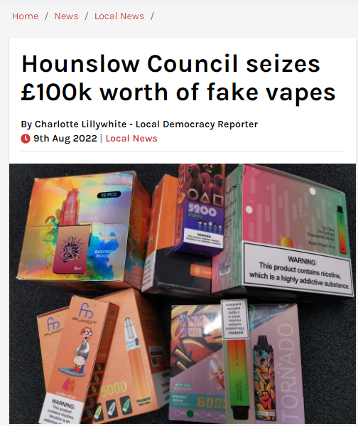
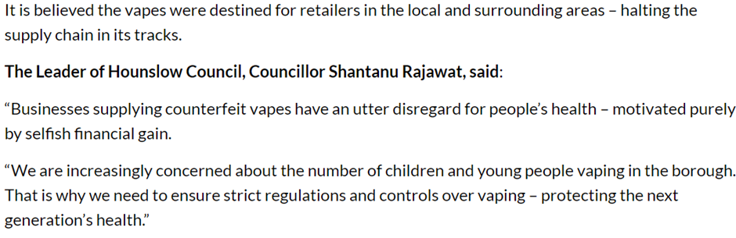
  The illegal and dangerous vapes are being sold in Hounslow

Slide 11
Fruity smell on their clothes, hair and breath.
Increased thirst, nosebleeds and an interest in stronger flavoured food and drink – vapes dry out the mouth and nose, leading to irritation and loss of sense of smell and taste.
Signs that your child is vaping
Physical side effects of vaping may include wheezing, headaches, cough, dizziness, sore throat, chest pain and allergic reactions such as itchiness or swelling of the lips.
Change in behaviour – vaping may lead to anxiety, irritability, difficulty concentrating and loss of appetite. If they are addicted to nicotine, craving and irritability can appear as quickly as 45 minutes after their last vape.
Items of kit – they can look like USB sticks, lip sticks, highlighter pens etc.

Slide 12
Having a conversation with your child
Find the right moment e.g. when you see someone vaping, walk past a vape shop or see adverts.
Let them know that you care about them. Explain that those who knowingly sell vapes to under 18s don’t care who they sell to and they are just interested in making money.
Talk about the different reasons why children may vape. Give examples such as wanting to fit in, curiosity, stress. Talk through effective ways to respond if they ever feel pressured to try it and practise role play scenarios for them to say no.
If your child is vaping, try to understand why they are vaping by asking questions like “What do you enjoy about vaping?” Or “How does vaping make you feel?”. Understanding this might help you to understand their needs and discuss other ways to meet those needs.
Ask questions. What do they think about vaping? Do they know people who vape? Why do they think people vape?
Talk about your expectations. Explain your concerns and tell them why you don’t want them to vape or smoke
Listen to them. Learn from them, but also use your knowledge to help them understand the facts and that vapes are not harmless.

Slide 13
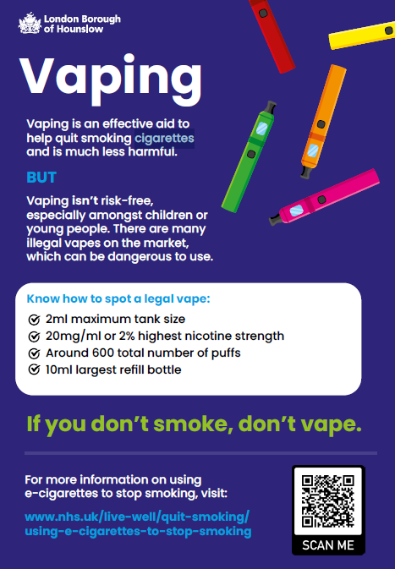
Look out for our poster and flyer
Get support to quit
Healthy Hounslow is a free service to help anyone aged 12+ stop vaping or smoking.
Find out more at https://healthyhounslow.co.uk
Or call 0204 559 8200

Slide 14


Thank you for listening.
Any questions?
www.healthyhounslow.co.uk

