Slide 1


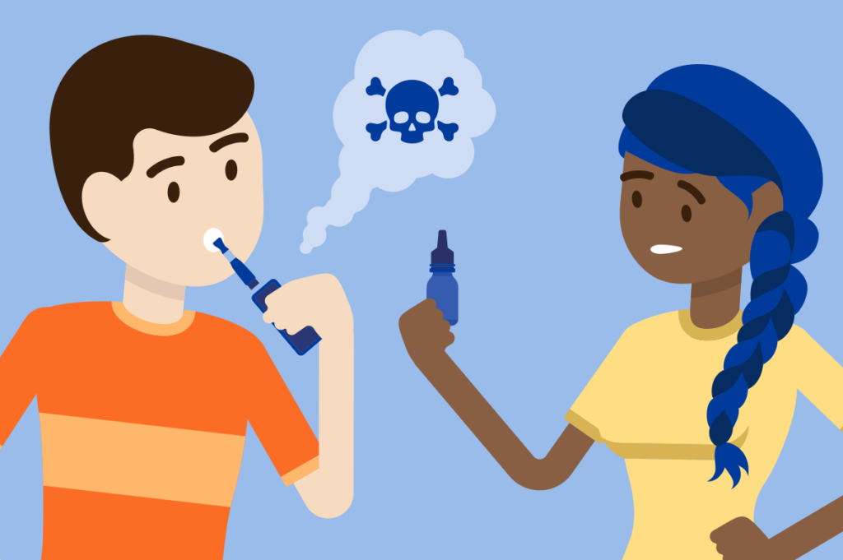


Vaping
www.healthyhounslow.co.uk

Slide 2


We know smoking is bad for our health
A regular smoker’s life expectancy is 10 years shorter than a non-smoker’s.
Cigarettes contain nicotine, tar, and chemicals such as Carbon Monoxide (CO).
Smoking-related deaths are mainly due to cancers (lung, plus 11 other types of cancer), chronic obstructive pulmonary disease (COPD), heart disease and stroke.
15% of Hounslow adults smoke. There is free support to help quit smoking from Healthy Hounslow.
Approx 50% of all smokers die from smoking-related diseases – about 100,000 per year in the UK.

Slide 3
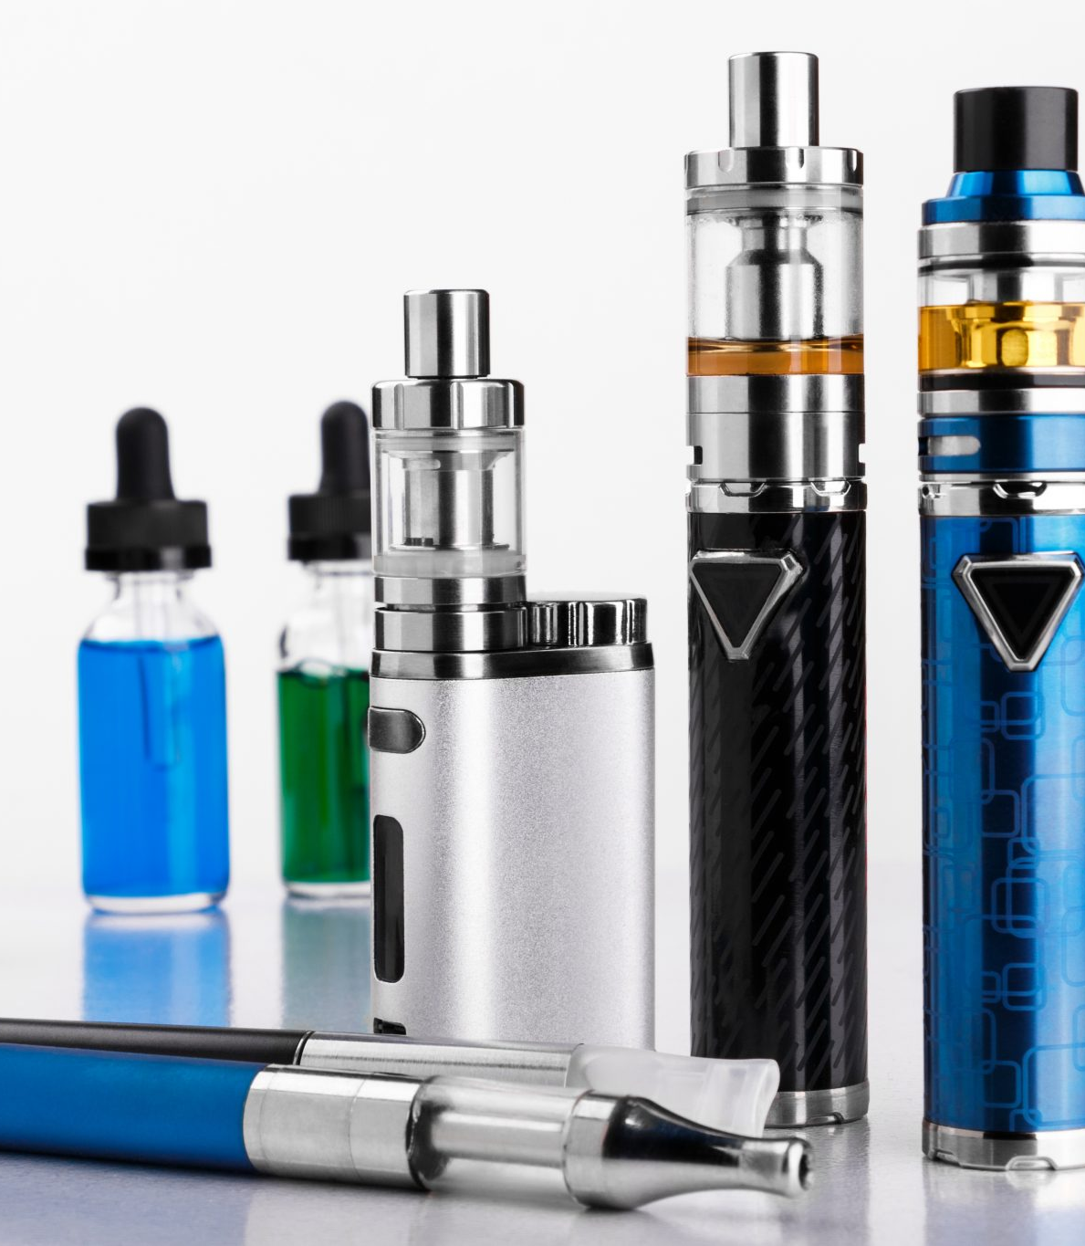

  But what about vaping?

Slide 4
What are vapes/e-cigarettes?
Vapes were first made to help people give up smoking cigarettes.
They contain harmful chemicals such as:
Propylene glycol – used to make antifreeze and paint solvent
Vegetable glycerin – found in soaps and deodorants
E-cigarettes, or vaping products, can be used to deliver nicotine, flavourings, chemicals, and other substances. They are known by many different names and come in many shapes, sizes, and device types.
Vapes don’t contain some of the very harmful chemicals that cigarettes do BUT they still contain many chemicals, and nicotine – this is a chemical which you can get addicted to and want more of. Cigarettes also contain nicotine.
So, they are good to help people give up smoking but are not good for anyone who never smoked.
If you don’t smoke, don’t vape.

Slide 5

Vaping: The Facts!

Slide 6

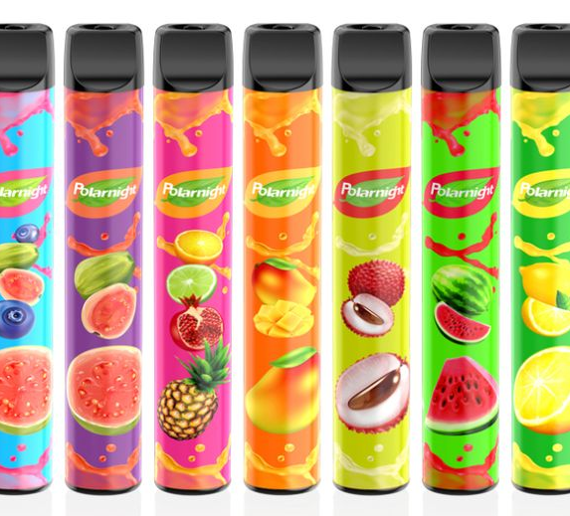


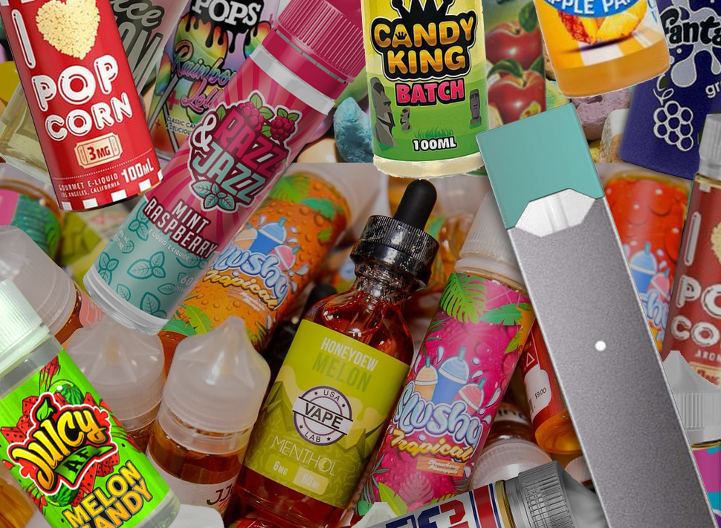


Vapes are often aimed at young people
Social media makes vaping look fun and attractive.
Flavours like fruit, chocolate, and candy in colourful packaging are aimed at children and young people.
If you become addicted to vapes and continue to buy them into adulthood, the companies who make them are profiting from you for longer.

Slide 7



“It’s cool – I’ve seen it on social media”
Why do you think some young people want to start vaping?
“I’m bored, I need something to do”
“I’m stressed & anxious – it might make me feel better”
“I’m curious, I’ll give it a try”
“My friends are all doing it”
Notes:
Ask them this first and go through one by one – there may be other suggestions from them.

Slide 8
Vaping is not safe for young people
Nearly all vapes contain nicotine, the addictive chemical found in cigarettes. If you use vapes often, you may get addicted to them and feel bad when you haven’t vaped for a while. This will make you bad-tempered and anxious and you won’t be able to concentrate well.
Vapes are still quite new, and little is known on the health effects on young vapers over time. Children and young people vaping today are our “guinea pigs”.
A young person’s brain is still developing, and scientists believe that nicotine could interfere with brain development. But more research is needed on this before they can be sure.
The chemicals in them cause coughing, headaches, dizziness, and sore throats, and can also have more serious effects on the heart and lungs.
Notes:
These are key facts that they need to know to help understand the health effects.

Slide 9






Why you should not try vaping
As well as the health risks, there are other factors…
They are expensive. What could you spend your money on instead of vapes?
Disposable vapes cost around £5. So, if you normally use 3 vapes per week, that would cost you £15 every week.
Instead, you could spend your money on…
School policies. Many schools have policies against vaping on school grounds. If caught, you may face disciplinary action.
An Odeon cinema ticket. At £6-8, you and a friend could go to see a movie and buy popcorn for the same price as 1 week with no vapes.
In the UK, it is illegal for retailers to sell vaping products to under 18s. These retailers can be reported to Hounslow’s Trading Standards team: tradingstandards@hounslow.gov.uk
A new Apple Airpods 2nd generation costs £129 = 8 ½ weeks without vapes.
Notes:
Ask what else could they spend the money on?

Slide 10



Illegal vapes
There are many dangerous, illegal vapes on the market…
Illegal vapes contain unknown chemicals and higher amounts of nicotine, with many more “puffs” than is safe. But they look the same as the legal ones.
Know how to spot a legal vape:
  2ml maximum tank size
  20 mg/ml or 2% highest nicotine strength
  Around 600 total number of puffs
  10ml largest refill bottle
There must be a clear label and a health warning: “This product contains nicotine which is a highly addictive substance” which covers 30% of the packaging.
The label must include a list of contents and have the appropriate hazard or danger warning signs.
Contact Hounslow Council’s Trading Standards for any concerns about illegal vapes sales and/or under-age sales of vapes (under 18 yrs) tradingstandards@hounslow.gov.uk
Notes:
Ask what else could they spend the money on?

Slide 11

What tips can you come up with to help young people stop vaping?
www.healthyhounslow.co.uk

Slide 12
Tips to stop vaping
1
Build a list of reasons to stop – you might find it helpful to write this down or keep note of it on your phone
2
Set goals – plan how and when you want to stop vaping. For example: starting tomorrow I will chew gum every time I get a craving for a vape
3
Seek support from friends and family – ask those you trust to help you stop vaping by providing emotional and practical support
4
Go to a healthcare professional for support – Healthy Hounslow can provide support for vaping

Slide 13
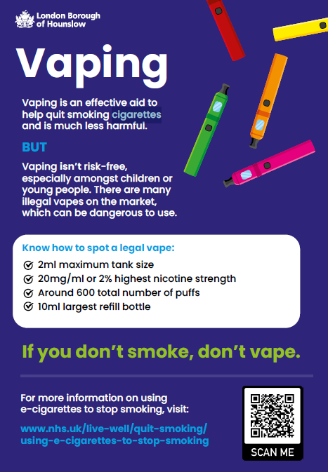
Healthy Hounslow
Healthy Hounslow is a free service to help anyone stop vaping or smoking.
If you need help, speak to your teacher or parent.
Find out more at https://healthyhounslow.co.uk
Or call 0204 559 8200

Slide 14


Thank you for listening
www.healthyhounslow.co.uk

